Slide 1
220711 Big Data P2 Presentation Group 2
Mengistu Desta
Aaniq Salam
Justin Ward
Benjamin Serio
Nithia James

Slide 2

Goals
Data Generation
Mass producing items for a database
Data Analysis
Best selling items, high traffic times and locales, etc.
Technology Familiarity
Hadoop, Spark, SQL, Python,
GitHub
Team Co-Ordination
Work delegation, communication, etc.

Slide 3

Our Data
Bookstore Sales
List of specific books sold on select websites internationally
Database Errors***
Geographical errors
Cities in wrong countries
Categories not well defined
Ex. History separately defined from Non-Fiction

Slide 4

Findings

Slide 5
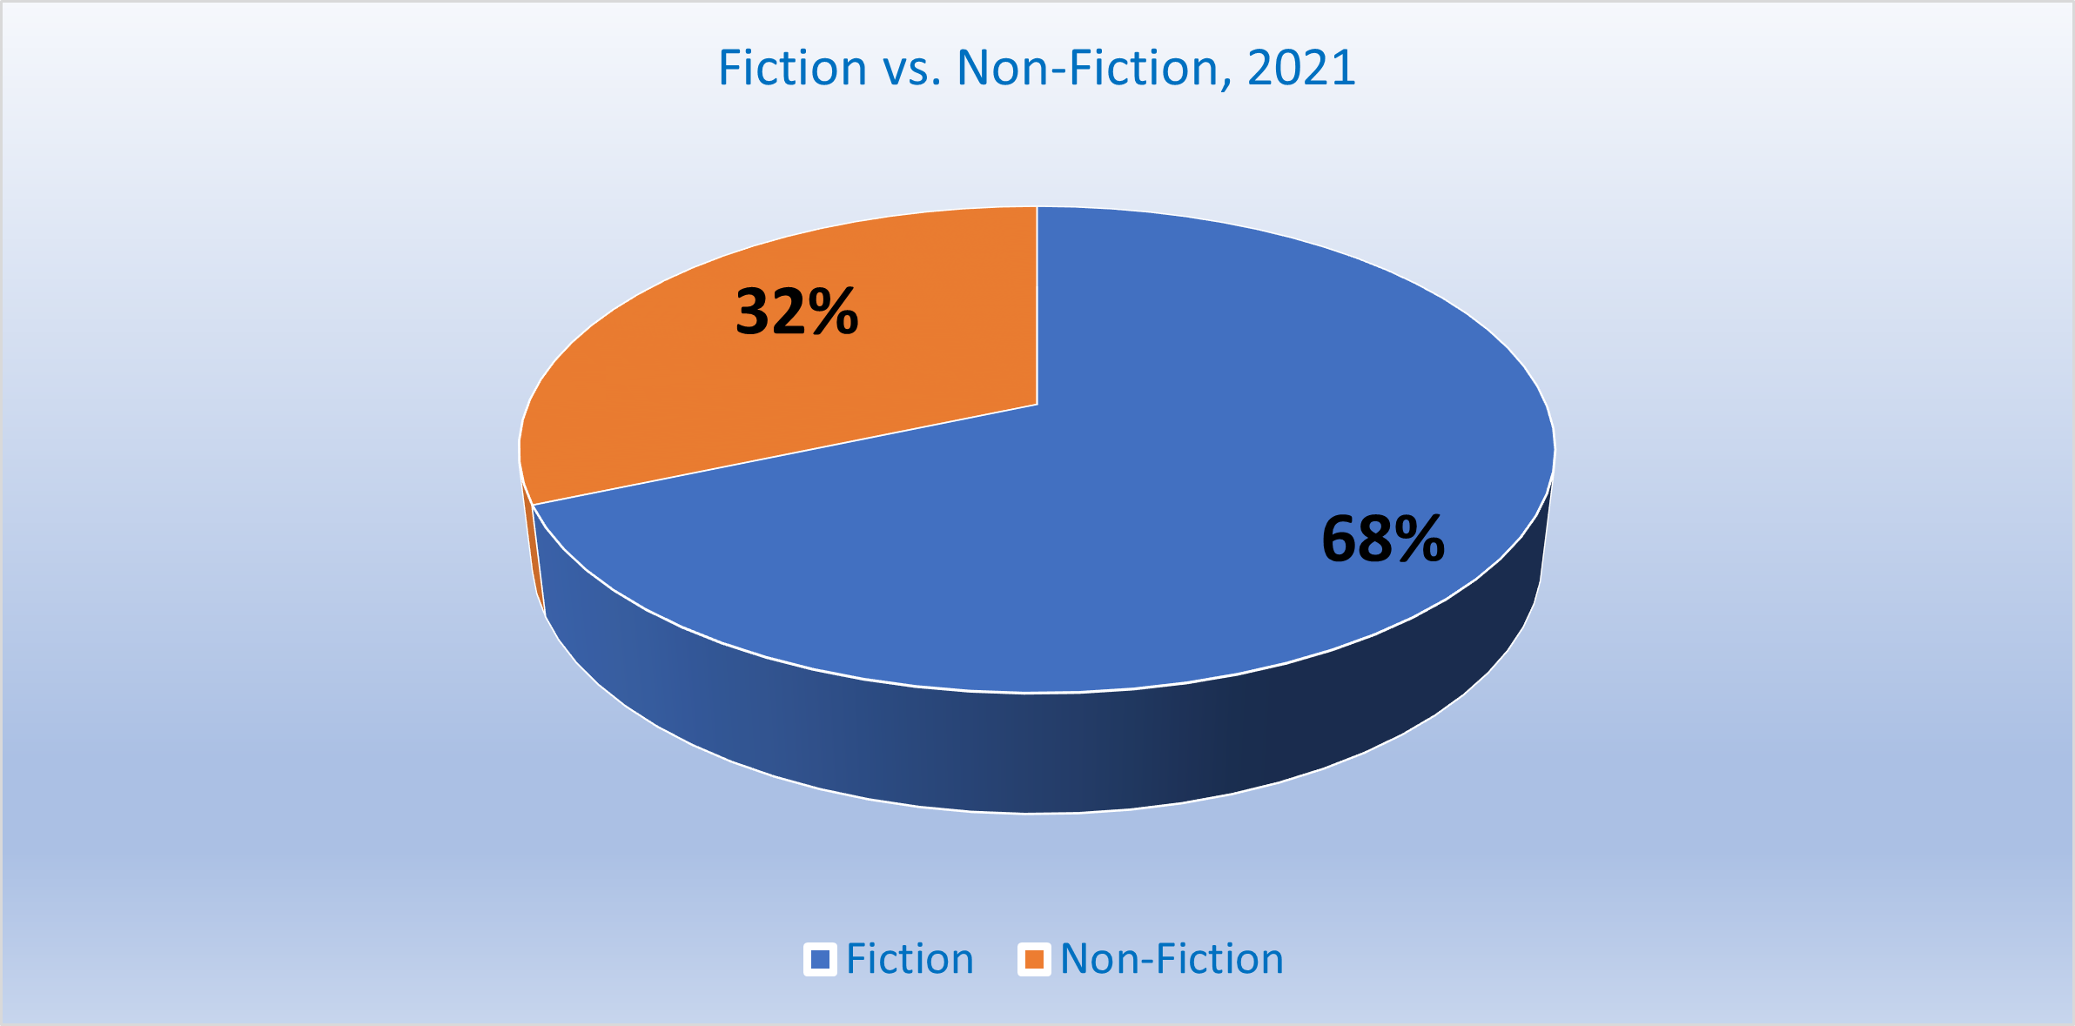
Top Selling Categories: Fiction vs. Non-Fiction (Mengistu)

Slide 6
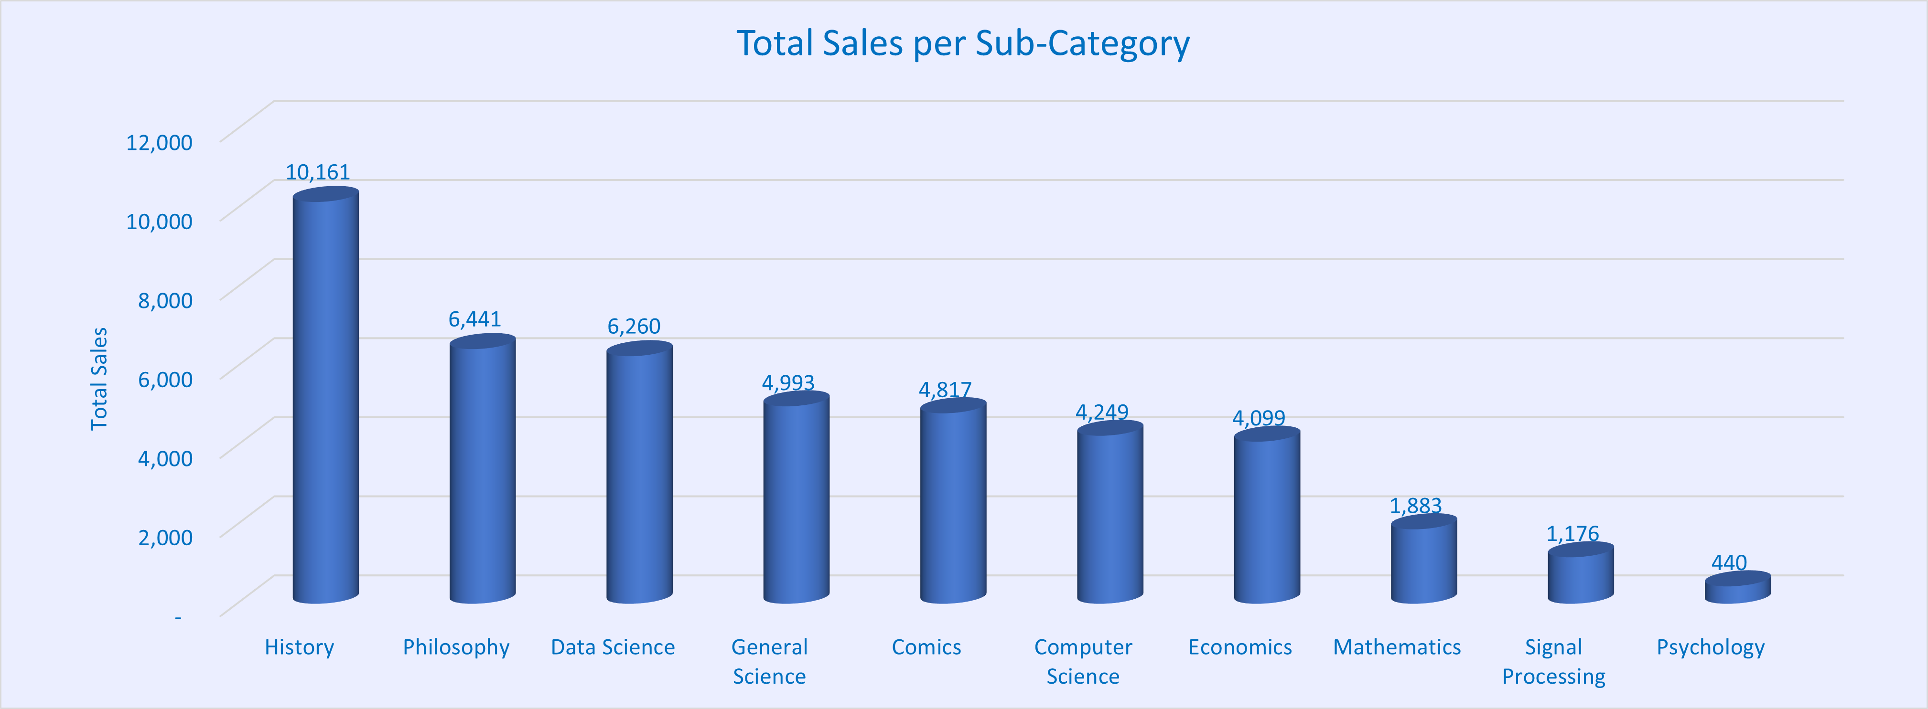
Top Selling Categories: Sub-Categories (Mengistu)

Slide 7
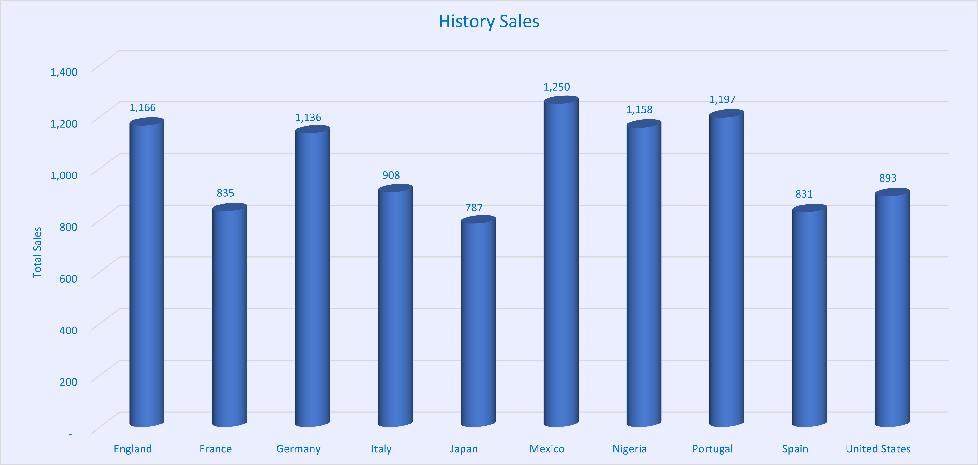
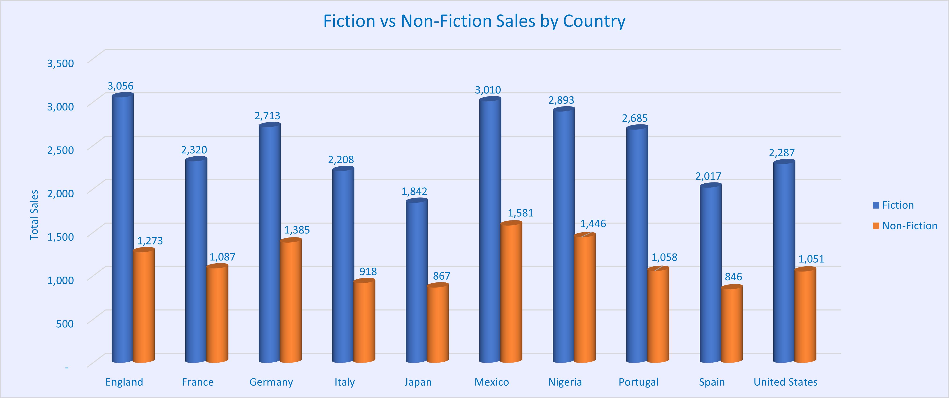
Top Selling Categories: Per Country (Mengistu)

Slide 8
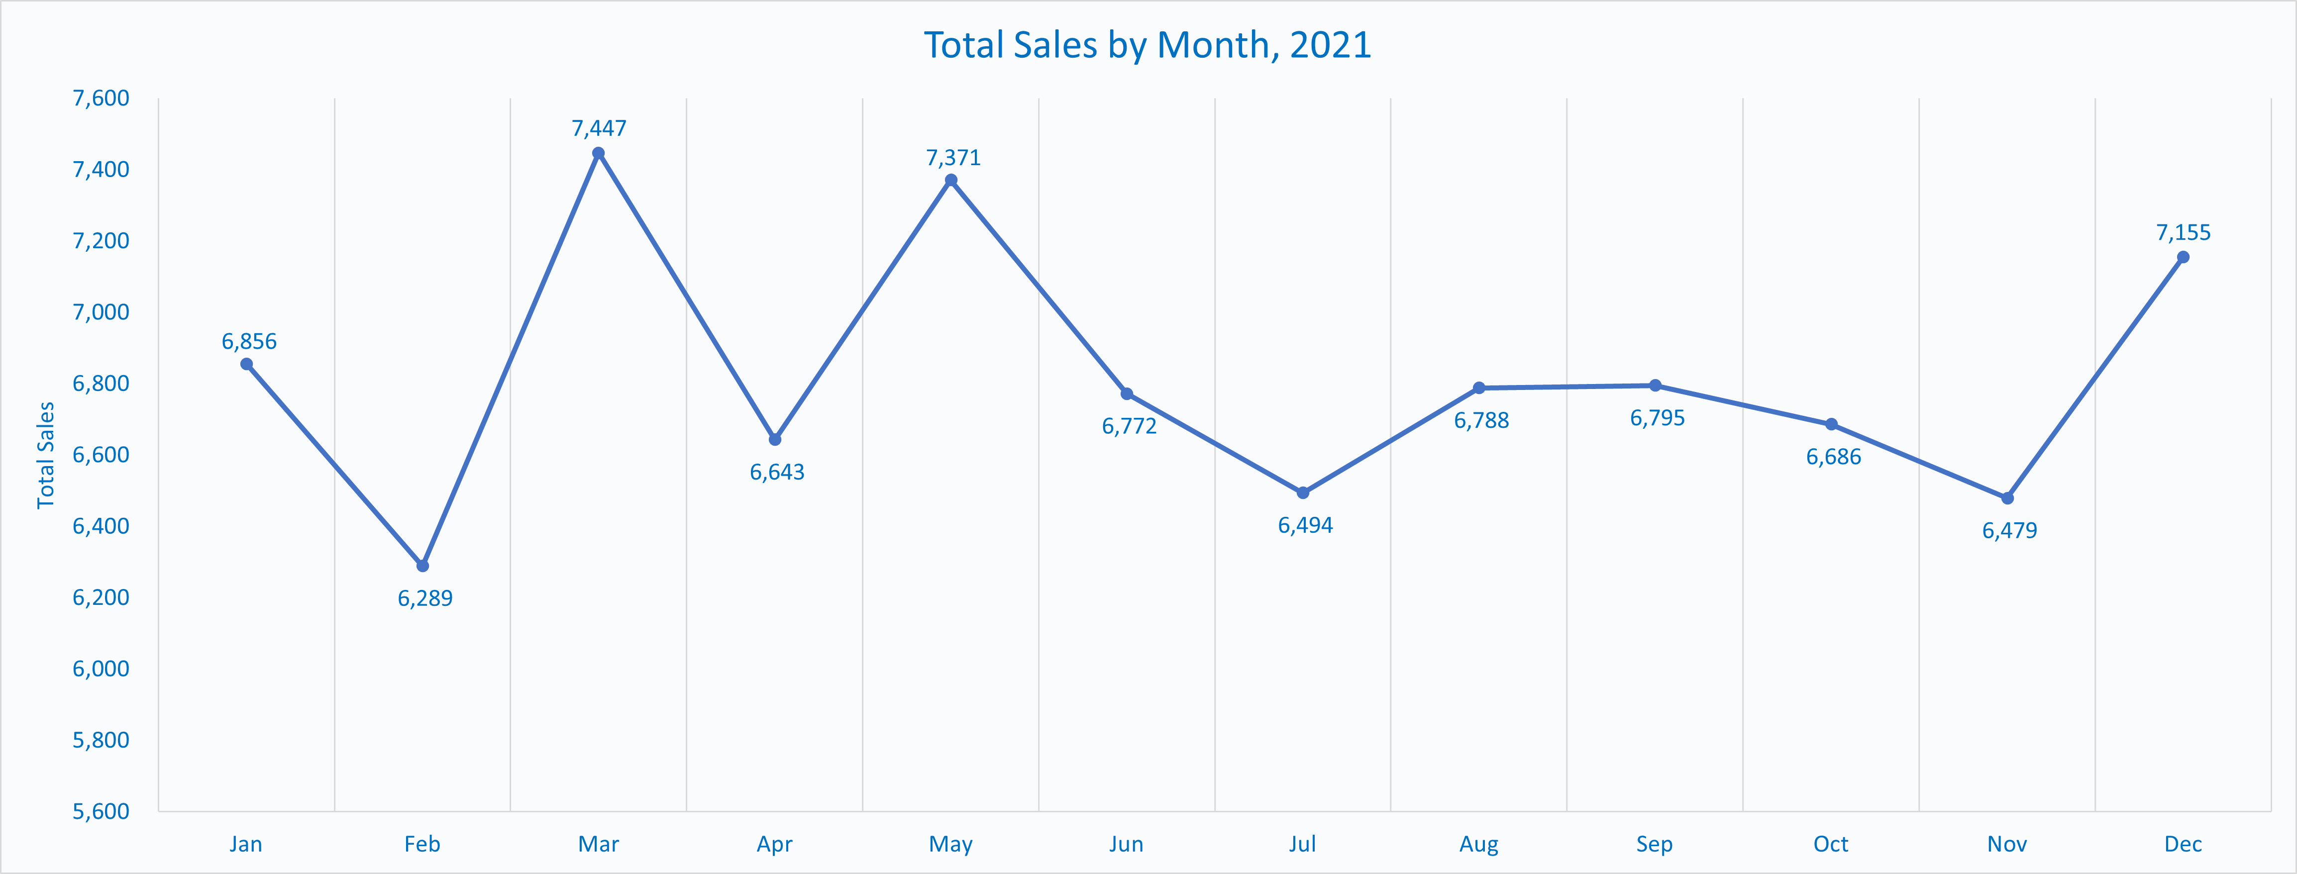
Monthly Sales Distribution, 2021 (Benjamin)

Slide 9
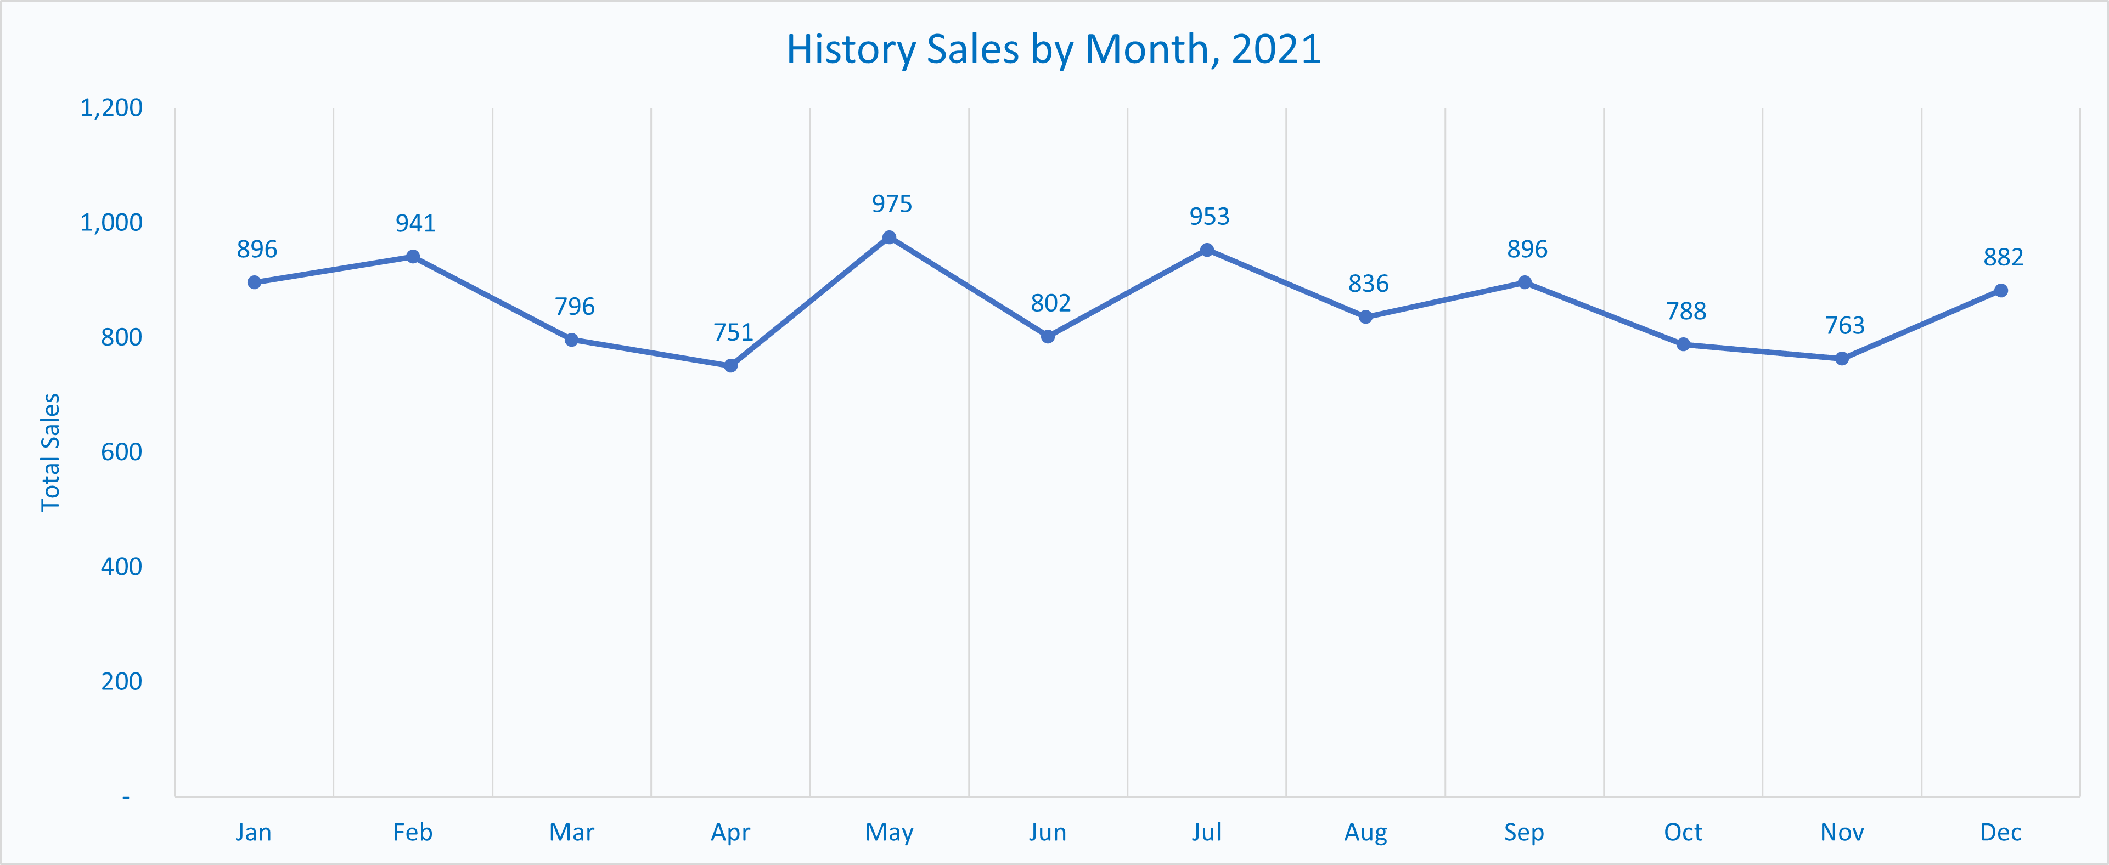
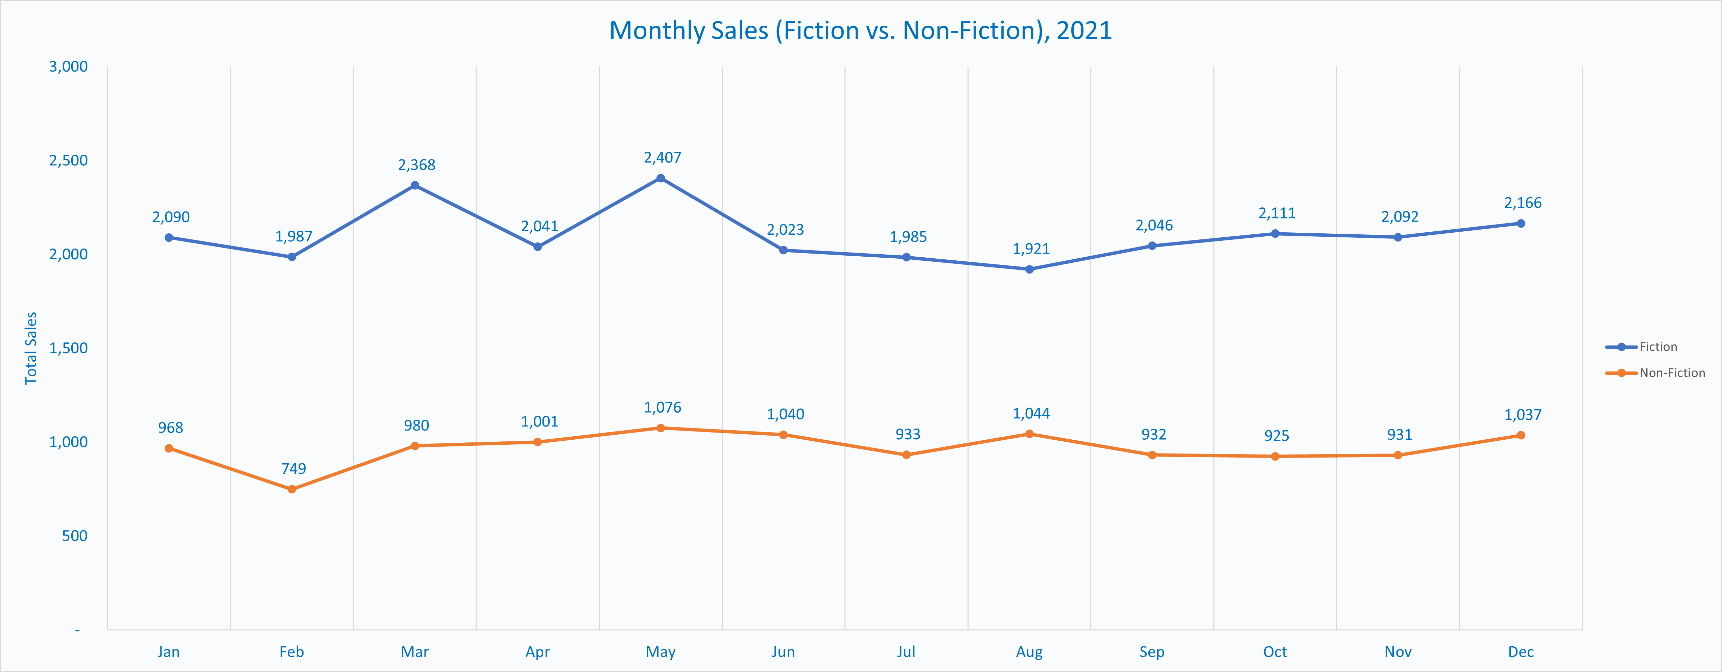
Monthly Sales Distribution: Categories (Benjamin)

Slide 10
Benjamin Slide (Per Country Breakdown)

Slide 11
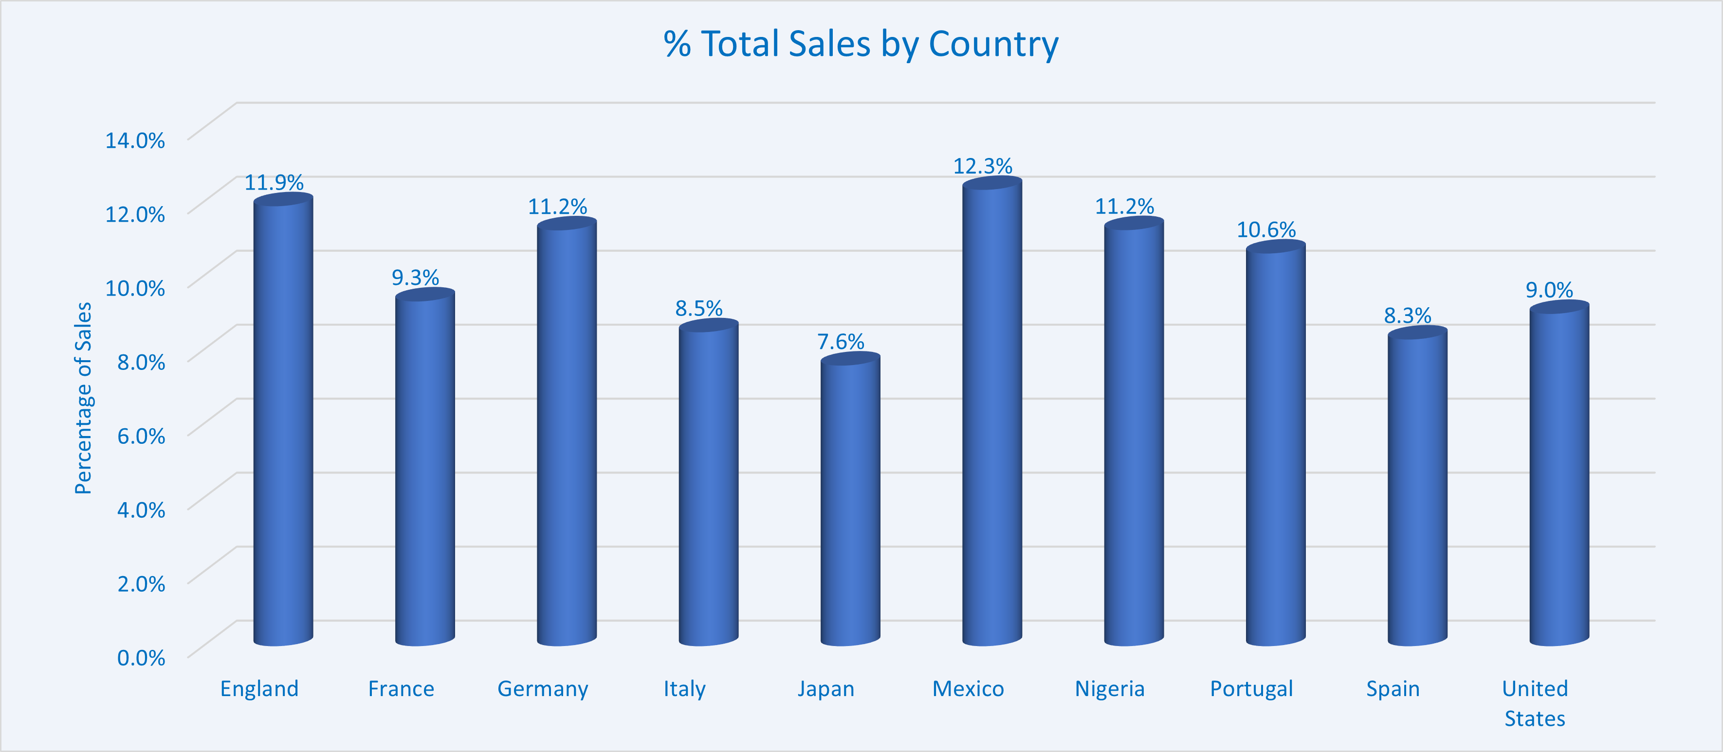
Global Sales Distribution (Nithia)

Slide 12
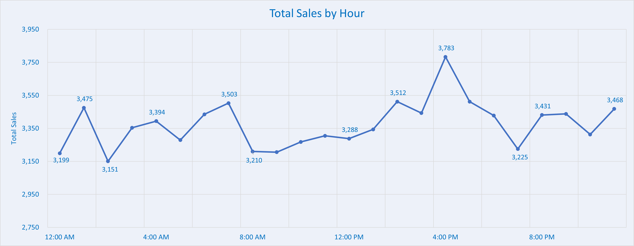
Sales Distribution Across Time (Aaniq)

Slide 13
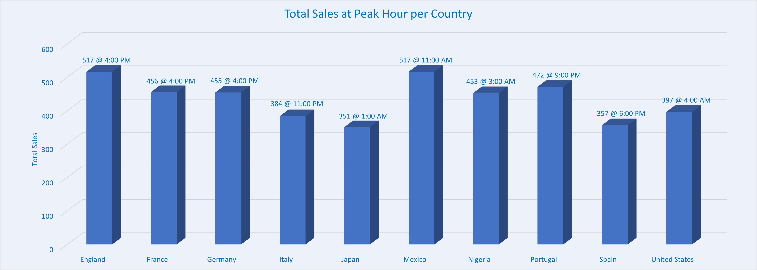
Comparisons of Peak Hours (Aaniq)

Slide 14
Additional Observations / Conclusion
I grow tired of charts.

